Slide 1







Analysis of the 2019 StackOverflow Survey
Alejandro Segovia Mera
01/14/2024

Slide 2



OUTLINE
Executive Summary
Introduction
Methodology
Results
Information about respondents
Age of Respondents
Remote Work
Compensation Information by Age and Gender
Developer Type
Information about technologies used
Discussion
Conclusion
Appendix

Slide 3

EXECUTIVE SUMMARY
Results from 2019 StackOverflow survey to know how often the respondents use the site.
Information about the respondents:
Age
Country
Gender
Income
Remote Work Frequency
Developer Type
Time spent to review code
Information about technologies used:
Languages currently used and future languages they will want to learn
Databases used and future databases they will want to use
Frameworks used

Slide 4

INTRODUCTION
Each year Stack Overflow organizes a survey in order to know how the coding habits of their respondents impacts the use of the webpage.
2018 survey was too long for some respondents.
Some questions weren't included in the previous survey.
This year, the survey is shorter and includes new questions.
11553 Respondents participated at the survey.
The answers provide useful information like the age of respondents, their annual compensations, their gender and the type of language and frameworks they like to use
From the results, we can conclude that efforts in communication are needed, so developers feel the need to visit StackOverflow to solve their coding issues.

Slide 5

METHODOLOGY
Data collected from the 2019 Stack Overflow Survey
Report organized in two parts:
Information about respondents
Study about the technologies used by respondents
Statistical Methods used to analyze the data:
Mean
Median
Distributions
Regressions

Slide 6
INFORMATION ABOUT THE RESPONDENTS

Slide 7
Age of Respondents

Slide 8

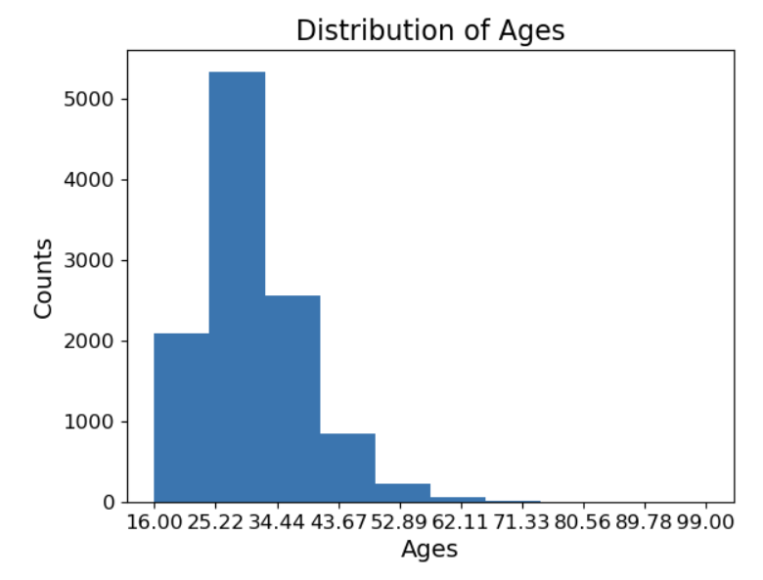
AGE OF RESPONDENTS
11553 Respondents participated in the survey
Only 11111 Respondents provided their age
The ages distribution is right-skewed
More than 5000 Respondents have over 30 years

Slide 9
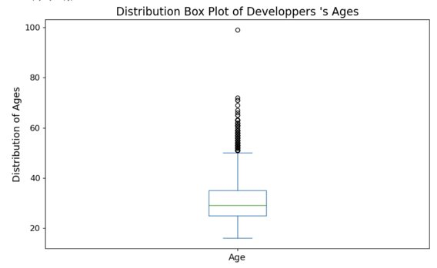
AGE OF RESPONDENTS
The average Rrespondent's age is 30.78 years.
The median is 29 years.
The first Quartile, Q1, has a value of 25 years.
The third Quartile, Q3, has a value of 35 years.
To have full statistical properties concerning age, see Appendix - Age.
Ages range from 16 to 99 years.

Slide 10
B)REMOTE WORK

Slide 11
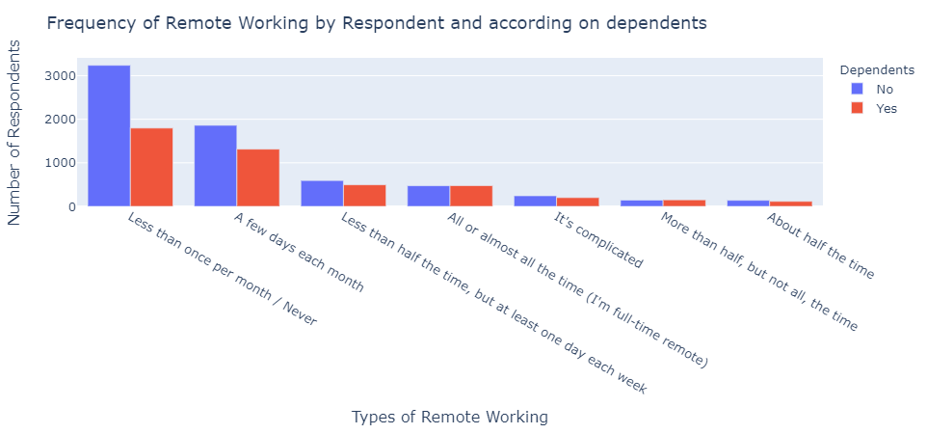
REMOTe work by dependents

Slide 12
REMOTe work by dependents
Most of the respondents work remotely less than once per month or Never.
Among the respondents who go often to the workplace, the ones who don't have dependents are very numerous.
The more respondents work remotely, the more the difference between the ones who have dependents and the ones who don't have, declines.

Slide 13
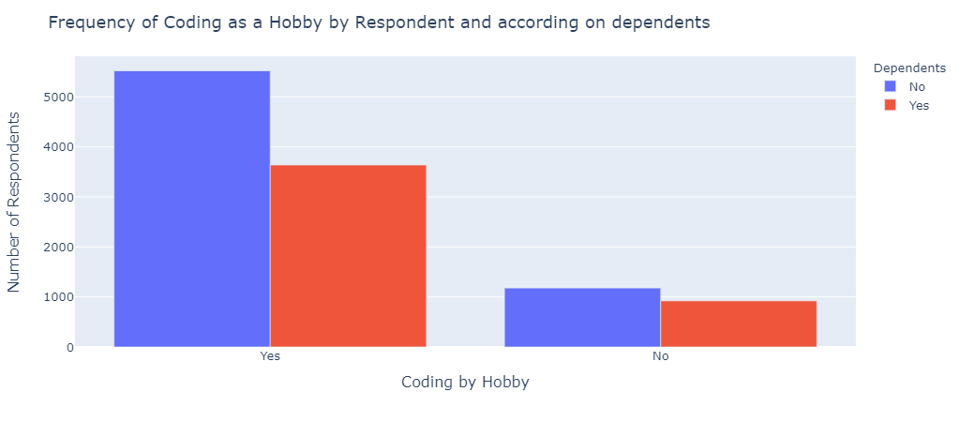
Coding as a hobby by dependents

Slide 14
Coding as a hobby by dependents
Most of the respondents code as a hobby.
The existence of "Dependents" is not an important factor on whether they code as a hobby or not.
However, people who don't have dependents and code as a hobby, are more numerous (60.2 %) that the ones who have dependents (39.8%).

Slide 15
C)Compensation information by age and gender

Slide 16
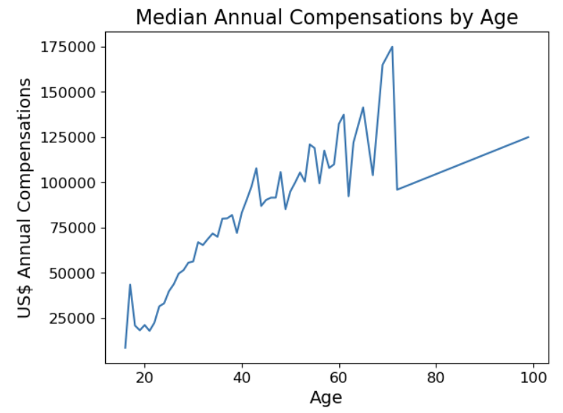
ANNUAL COMPENSATIONS BY AGE
Median Annual Compensations (MAC) range from 8.7k$ to 175k$.
Ages range from 16 to 99 years.
MAC are linearly related to age (Pearson = 0.88, p = 3.29e-19).
For a detailed statistical understanding, see Appendix.

Slide 17
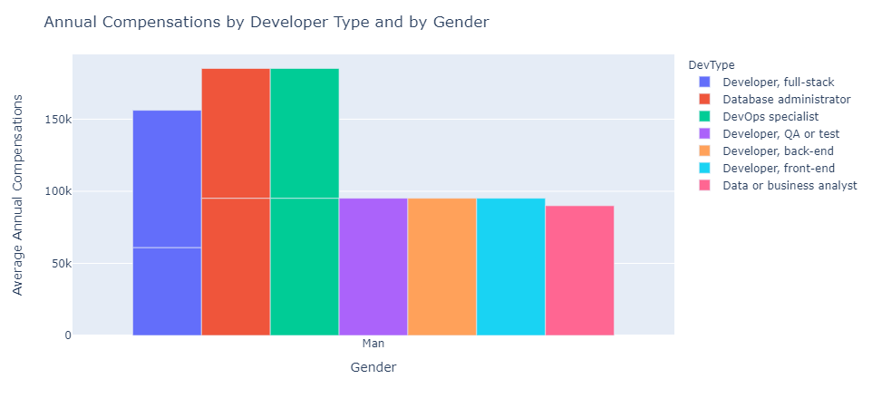
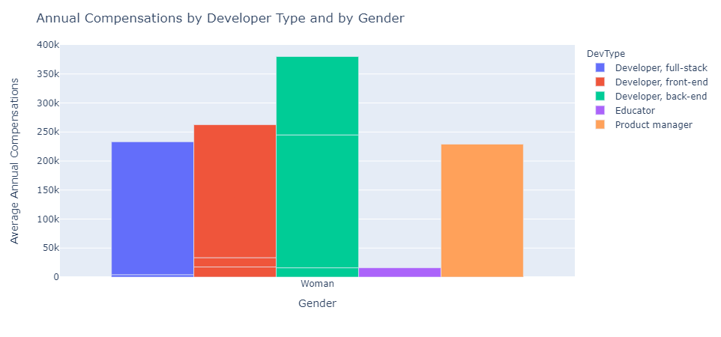
ANNUAL COMPENSATIONS BY GENDER
Women tend to earn more compensations than men.
More Developer Types are represented by men compared to women.

Slide 18
D)Developer Type

Slide 19
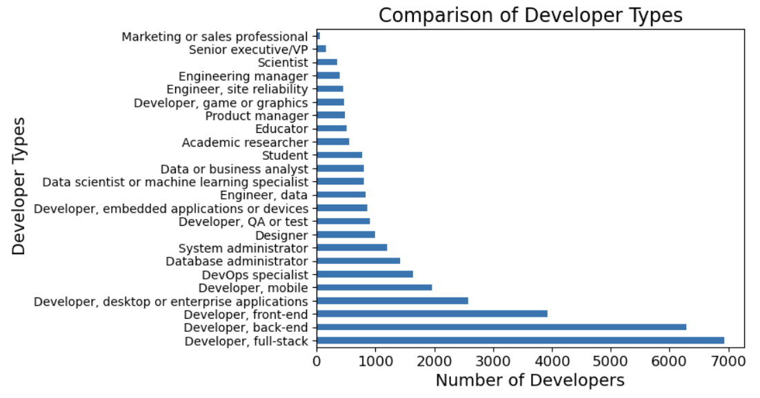
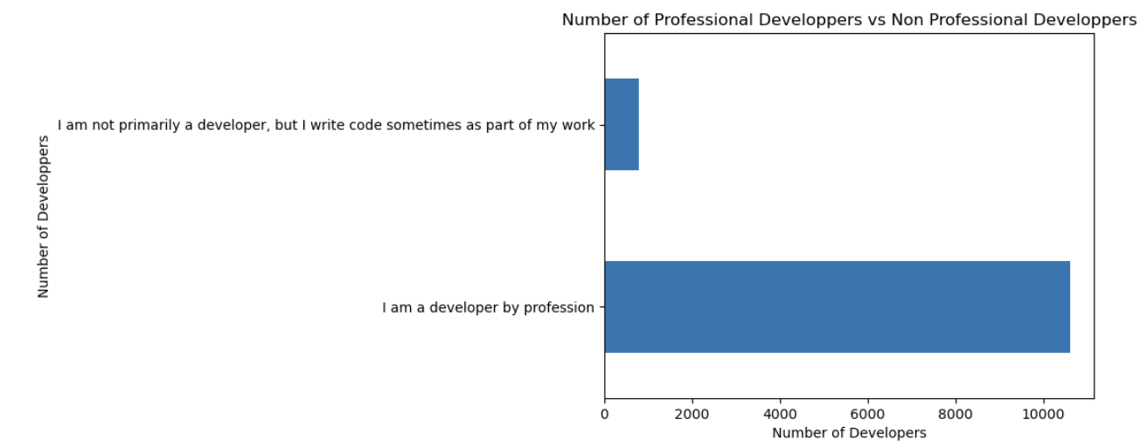
Type of Developers

Slide 20
Type of Developers
More than 10k are Professional developers vs 100 Non-Professional developers.
The most represented Developer Type is the Full-Stack type

Slide 21
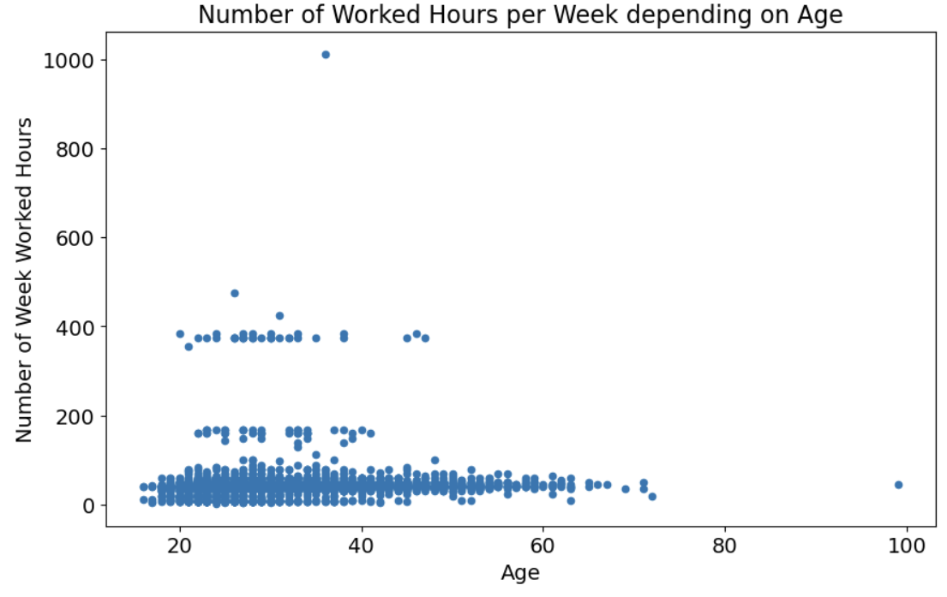
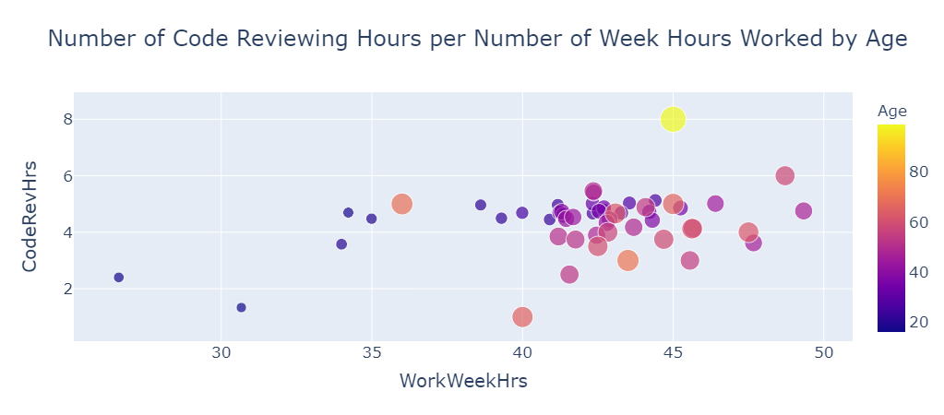
Relationship between Age and Code Review

Slide 22
Relationship between Age and Code Review
No linear relation exists between the Number of Week Worked Hours and Age.
Pearson = 0.03 and p = 0.12e-3
Most developers spend only 10% of their time reviewing code.

Slide 23
2)INFORMATION ABOUT THECHNLOGIES USED

Slide 24
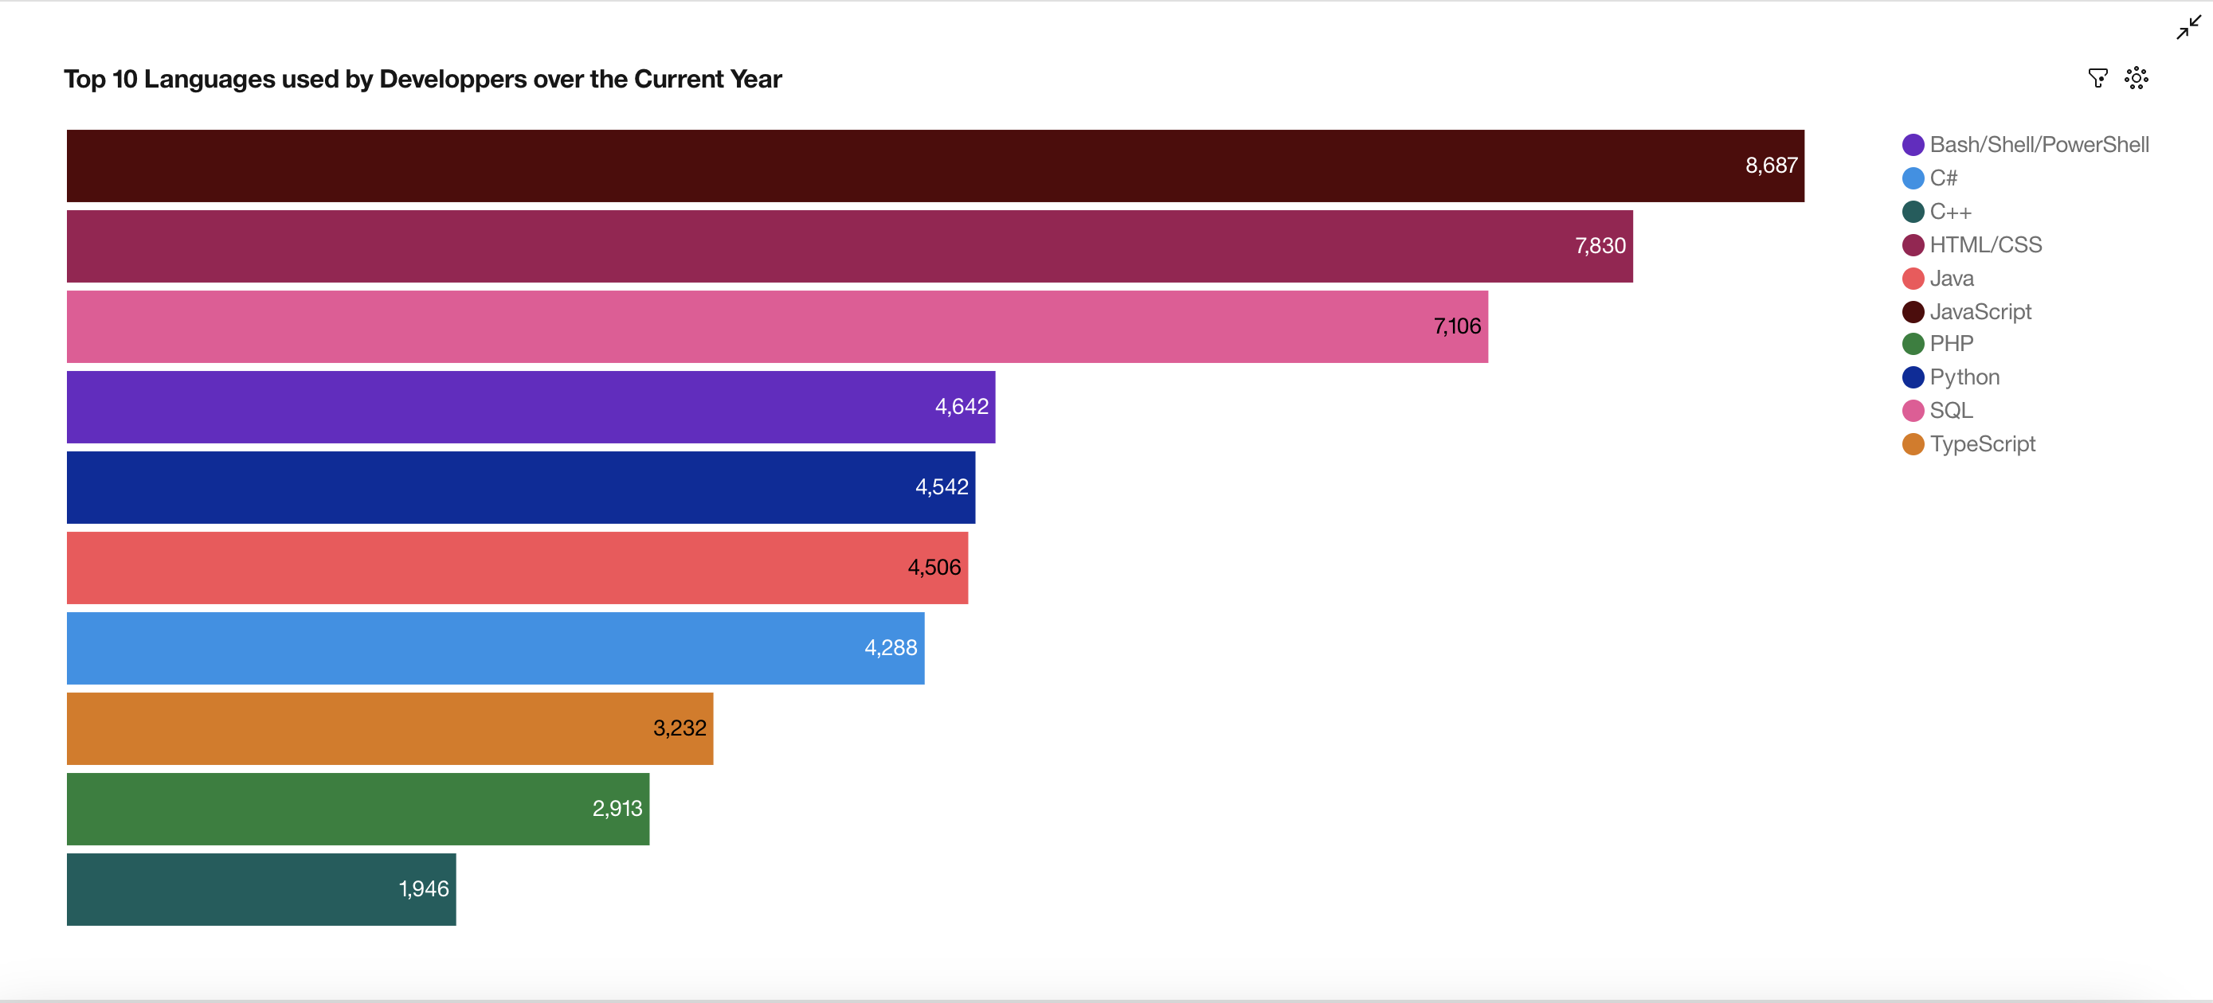
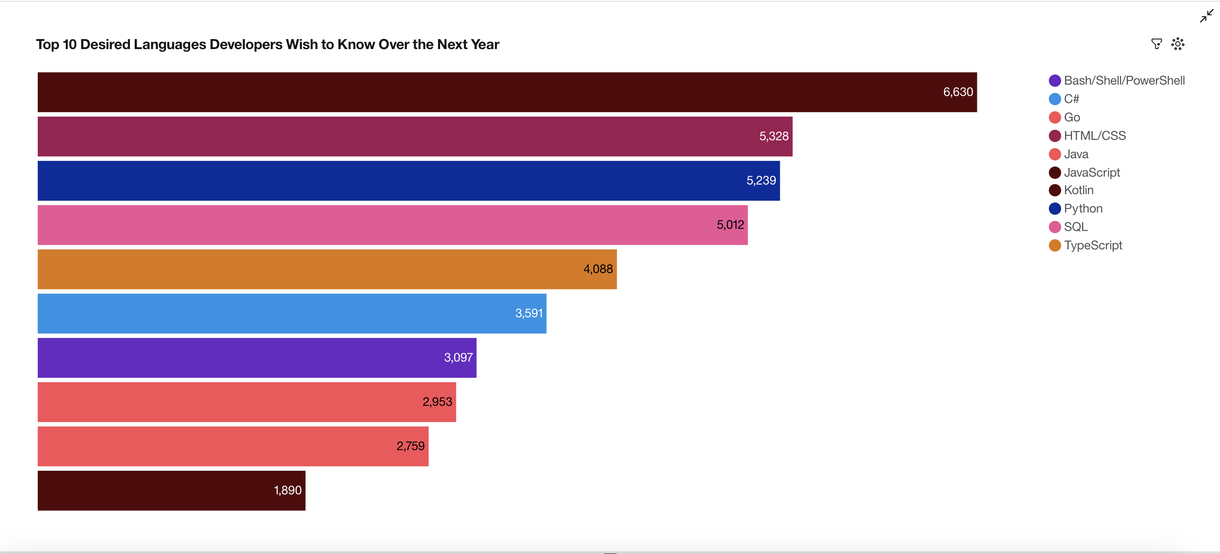
PROGRAMMING LANGUAGE TRENDS
Current Year
Next Year

Slide 25
PROGRAMMING LANGUAGE TRENDS - FINDINGS & IMPLICATIONS
Findings
JavaScript is the preferred language for the current next year.
HTML is the 2nd preferred language for the current year.
SQL is the 3rd preferred language for the current year.
Implications
JavaScript is the preferred language the next year.
HTML is the 2nd preferred language the current year.
Python is the 3rd language the next year.

Slide 26
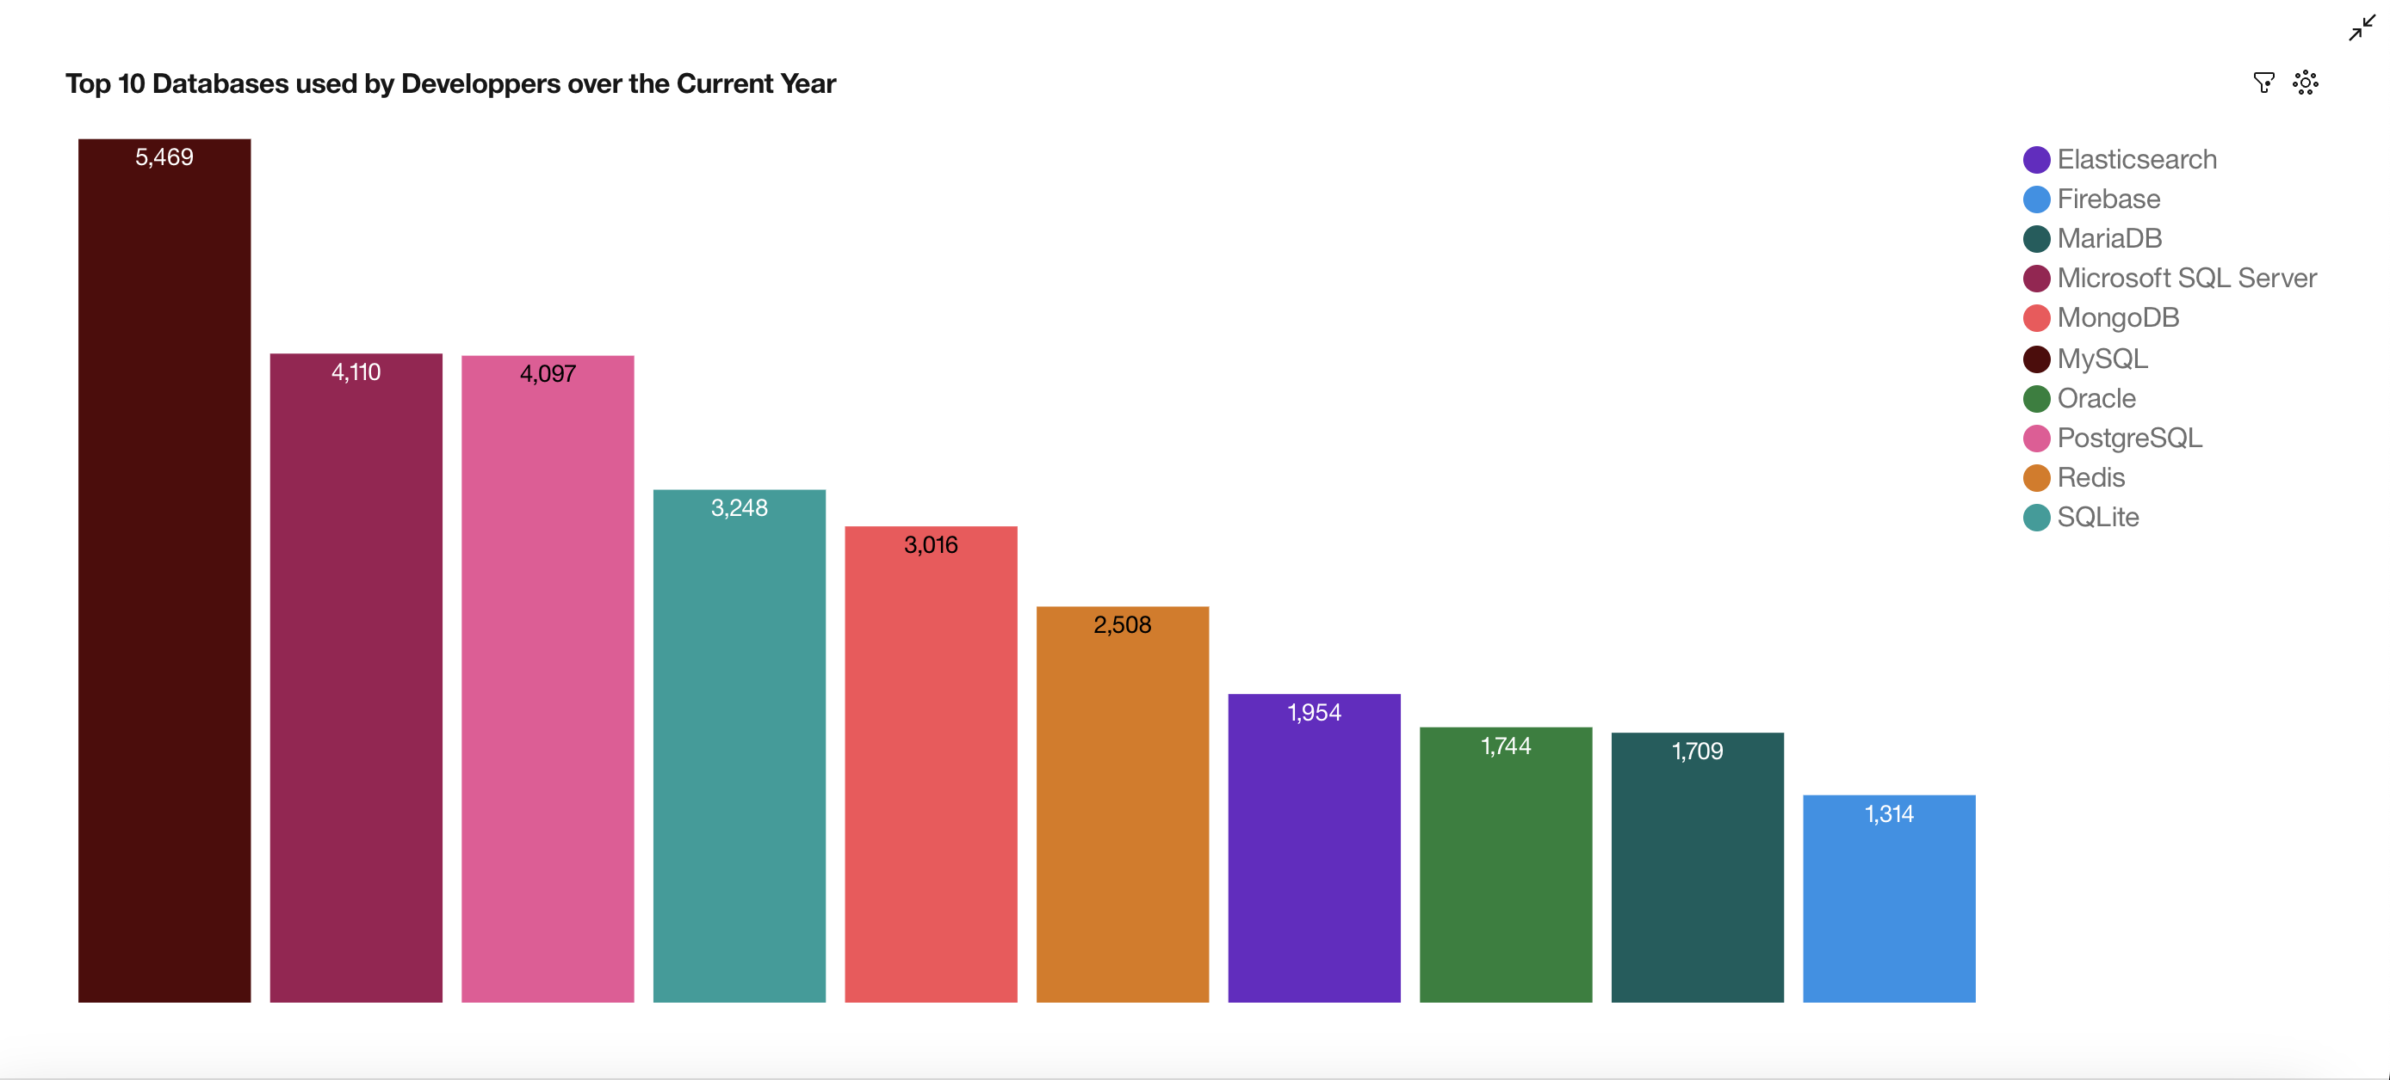
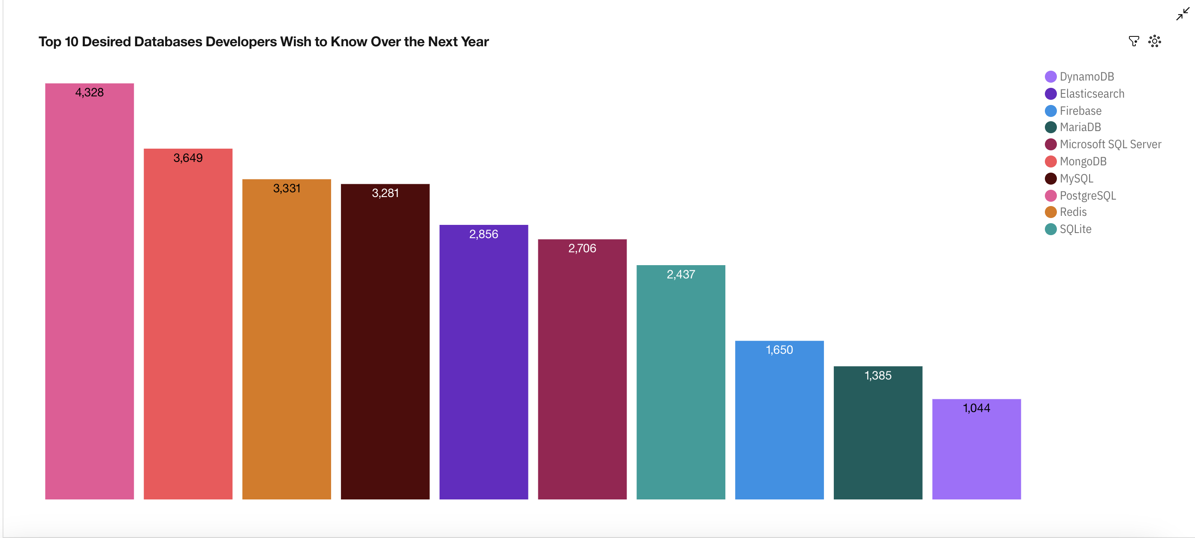
DATABASE TRENDS
Current Year
Next Year

Slide 27
DATABASE TRENDS - FINDINGS & IMPLICATIONS
Findings
MySQL is the preferred Database used by Developers for the current year.
Microsoft SQL Server is the 2nd preferred Database used by Developers for the current year.
PostgreSQL is the preferred Database used by Developers for the current year.
Implications
PostgreSQL will be the preferred Database Developers wish to learn the next year.
MongoDB will be the 2nd preferred Database Developers wish to learn the next year.
Redis will be the 3rd preferred Database Developers wish to learn the next year.

Slide 28
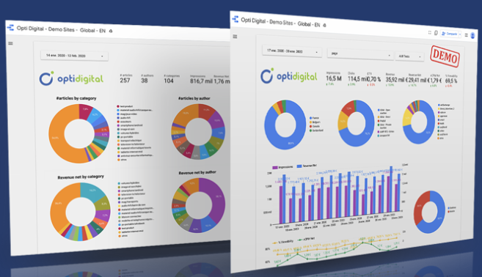
DASHBOARD
To have a dynamic vision of the dashboard, you can click on the following link: Dashboard Link

Slide 29
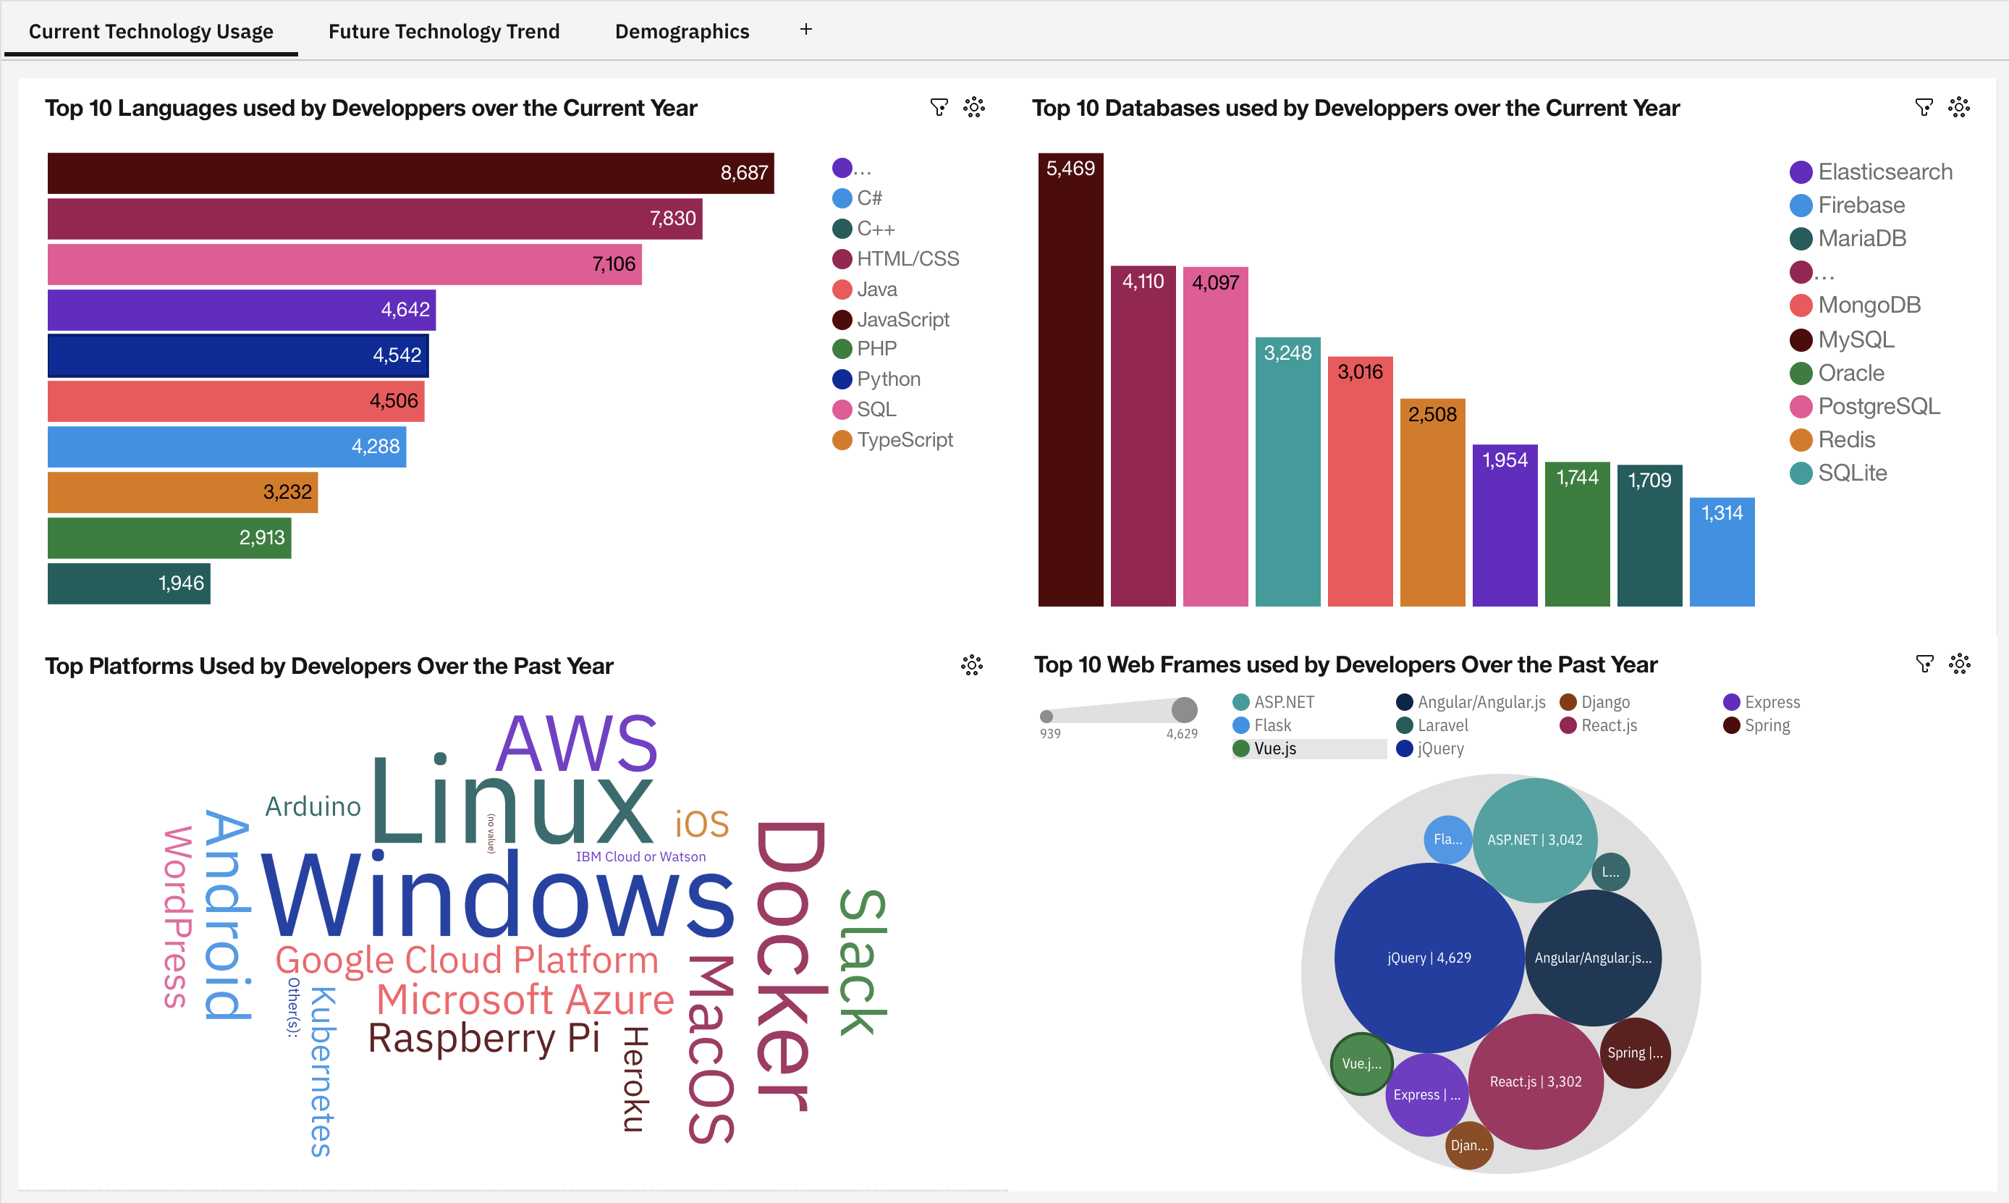
Current Technology Usage

Slide 30
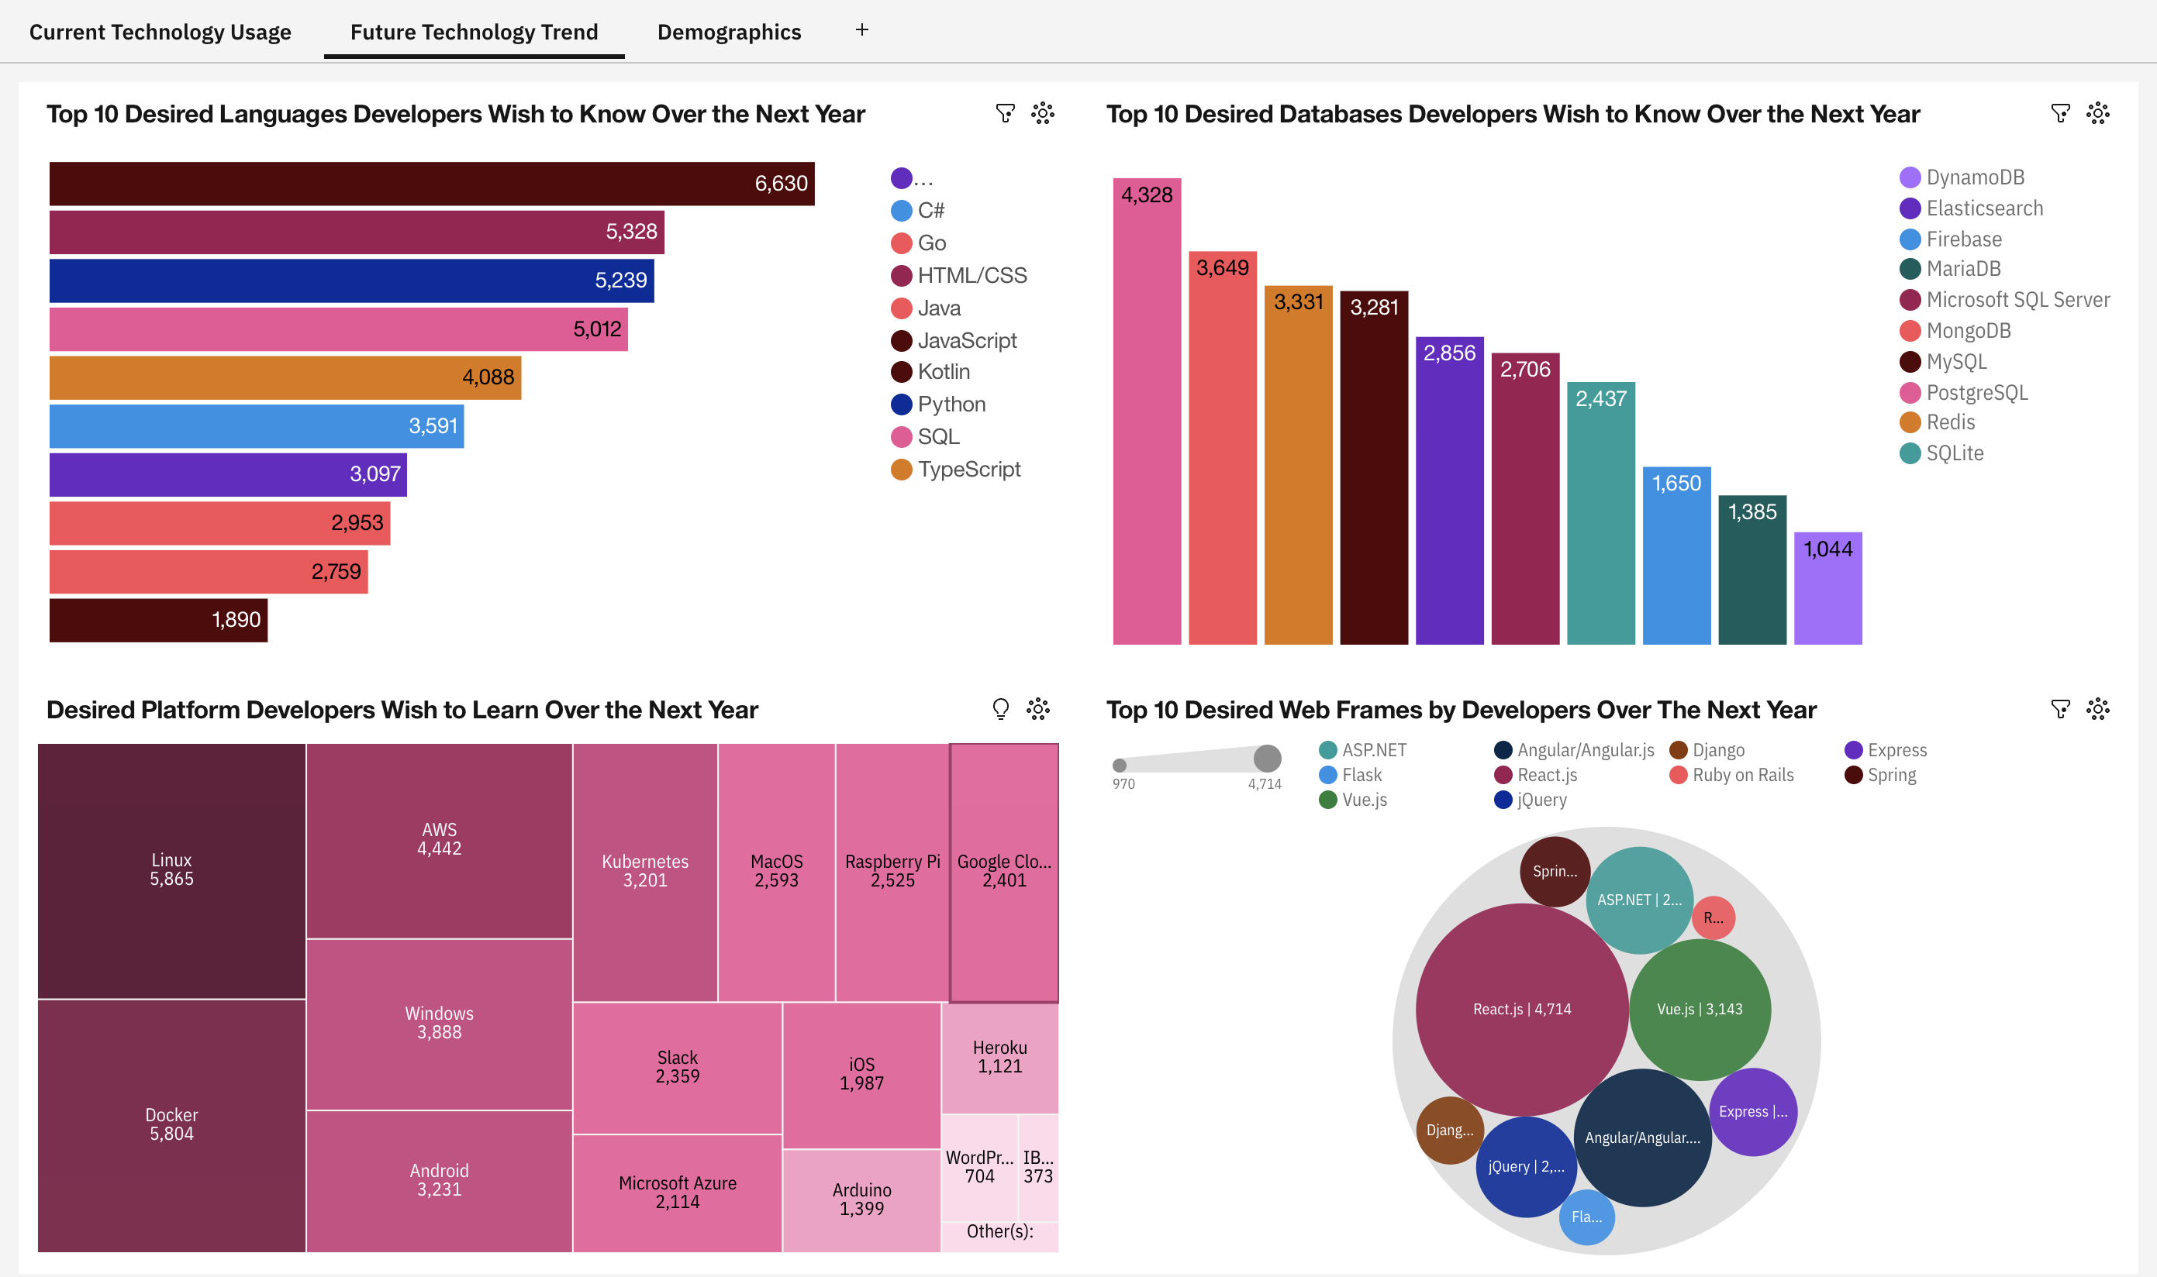
Future Technology Trend

Slide 31
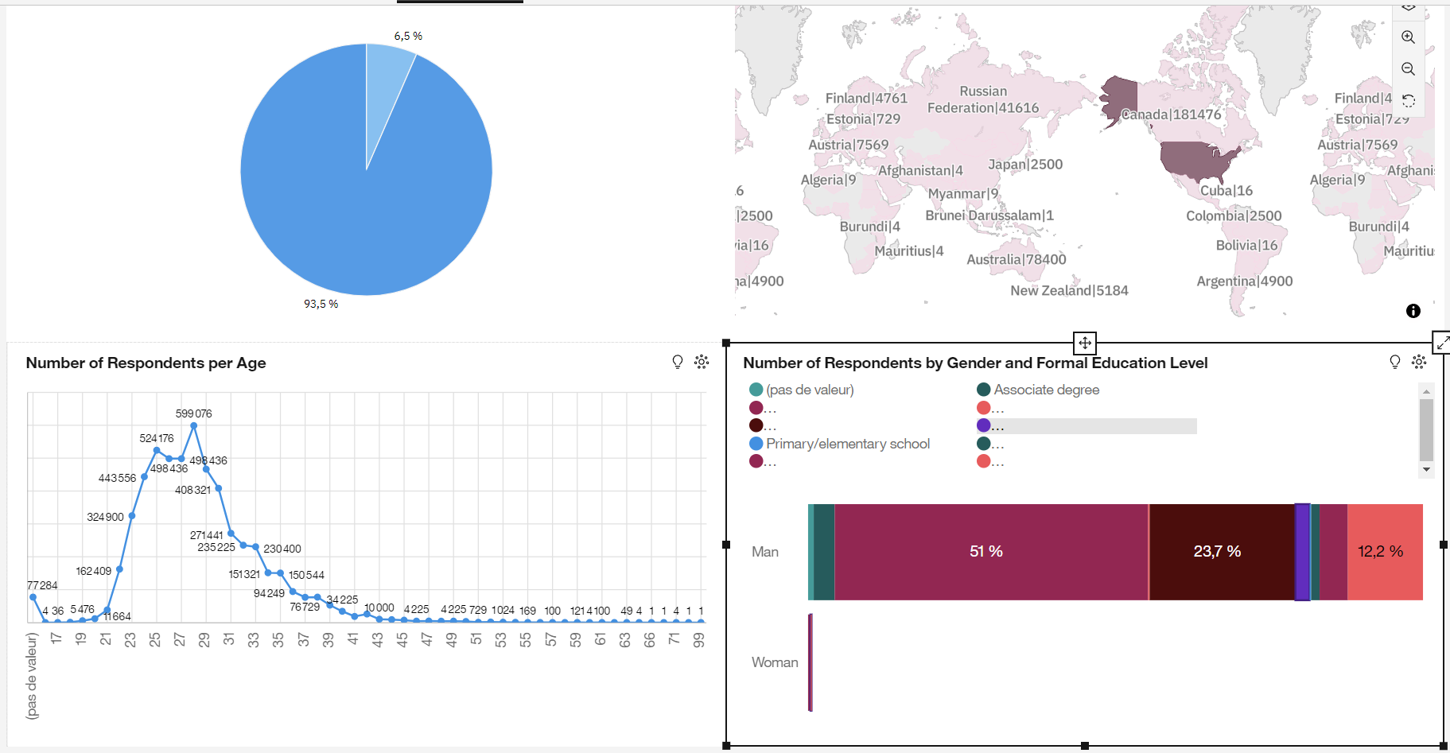
Demographics

Slide 32
Demographics
Most of the respondents come from The United States.
93.5 % of respondents are men vs 6.5% of women.
51 % of male respondents earn a Bachelor's Deegree.

Slide 33



DISCUSSION

Slide 34
DISCUSSION – Age and habits of respondents
The majority of respondents are young people.
Most of them go frequently to the office and don't have dependents.
Very little respondents code as a hobby.
Insights:
StackOverflow is blocked at some workplaces --> Expand the product "For Teams" to some companies.
Improve companies data security.
Organize contests to encourage the remaining developers to start coding as a hobby.

Slide 35
DISCUSSION – Annual Compensations
It is normal for incomes to increase between the ages of 25 to 30 years.
Many developer types are represented by men.
Insights:
To sell again merchandise, because young people is more eager to consume.
Encourage women to discover new developer types:
More advertising.
Visitng Schools and organizing activities and talks.

Slide 36
DISCUSSION – Professional vs non-professional developers
The time spent by developers to review code is very few.
Age and experience are not important factors to determine if a developer reviews his code very often.
Insights:
Write posts in the blog about the importance to review code very frequently.

Slide 37
DISCUSSION – Technologies used
Python is becoming a popular language amongst developers.
However JavaScript is still the Number 1.
MySQL and Postgre SQL are the preferred Databases used by developers.
Insights:
Create more content aobut Python, JavaScript, MySQL and PostgreSQL.

Slide 38
OVERALL FINDINGS & IMPLICATIONS
Findings
Many respondents are young people without dependents.
Respondents don't review their code very often
JavaScript is and will be the preferred language of respondents.
Python is the 3rd language, developers wish to learn in the future.
Men are more represented than women.
Most of the respondents come from the USA.
Implications
Encourage people from all ages to visit the webpage.
Create encouragement strategies through the blog.
Create a special Category for JavaScript developers.
Create a special Category for Python developers.
Work towards more gender equality.
More advertising for the rest of the World.

Slide 39

CONCLUSION
Respondents are younger people.
More work needs to be done in advertising and encouragement.
The blog is necessary in order to motivate developers to review their code.

Slide 40
Additional value
It will be interesting to engage discussions with CEO's and politicians around the World to encourage the use of computers and programming in countries that don't have access to technology (poor countries, emerging countries, etc..).
Therefore, StackOverflow can be implemented as the Number 1 Worldwide Open Source web page to solve coding problems.

Slide 41


Slide 42
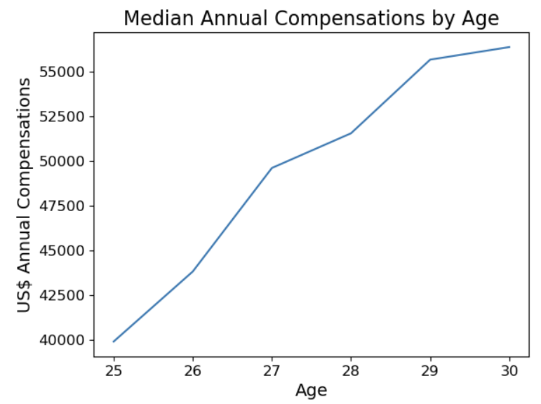
ANNUAL COMPENSATIONS BY AGES 25 TO 30
MAC varies from 39 k$ to 56 k$.
MAC and Age are linearly related.
The slope is steep.
Pearson = 0.98, p = 6e-4

Slide 43
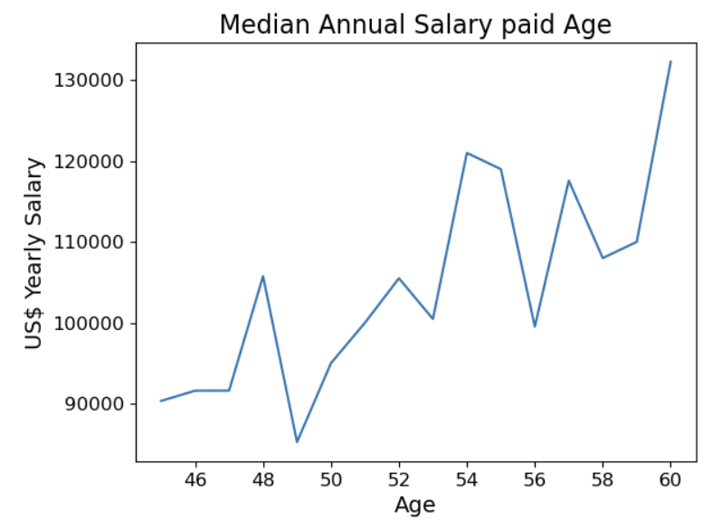
ANNUAL COMPENSATIONS BY AGES 45 TO 60
MAC varies from 85 k$ to 132 k$.
MAC and Age are linearly related.
The slope is less steep and uniform
Pearson = 0.77, p = 44e-5

Slide 44
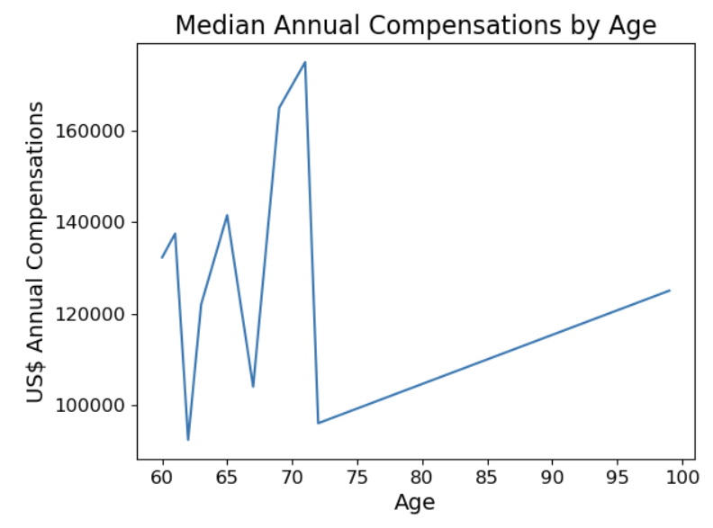
ANNUAL COMPENSATIONS BY AGES 60 TO 99
MAC fluctuates between 92 k$ and 175 k$.
MAC and Age are less linearly related.
The slope is less steep and uniform
Pearson = 0.02, p = 0.94

Slide 45
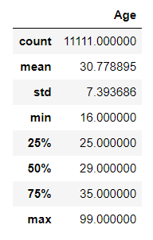
APPENDIX - Age
Table of the full statistical description concerning the Respondent's age.

Slide 46
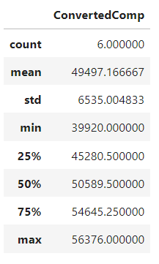
APPENDIX – Compensations Ages 25 to 30
Table of the full statistical description concerning Compensations for ages 25 to 30.

Slide 47
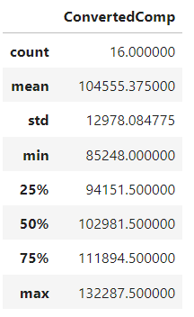
APPENDIX – Compensations Ages 45 to 60
Table of the full statistical description concerning Compensations for ages 45 to 60.

Slide 48
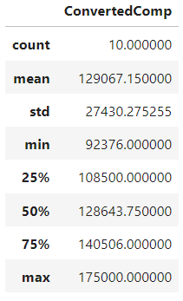
APPENDIX – Compensations Ages 60 to 99
Table of the full statistical description concerning Compensations for ages 60 to 99.

Slide 49
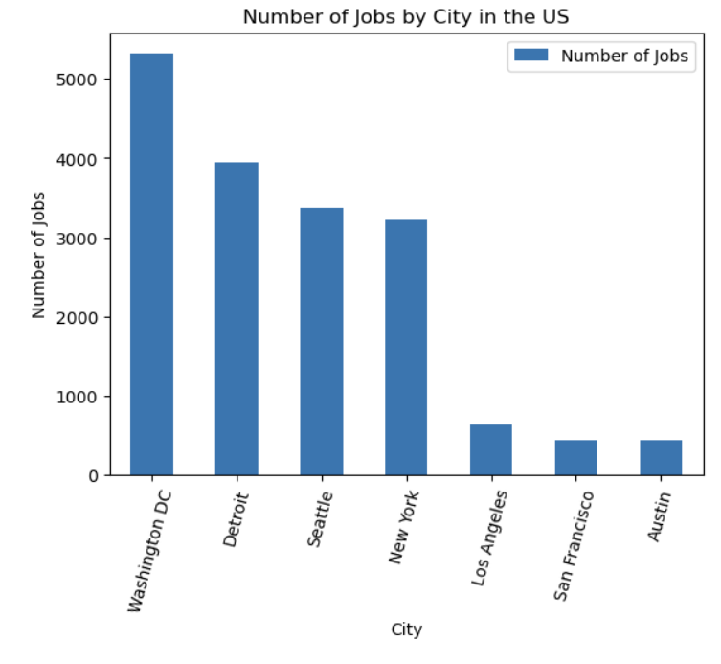
JOB POSTINGS

Slide 50
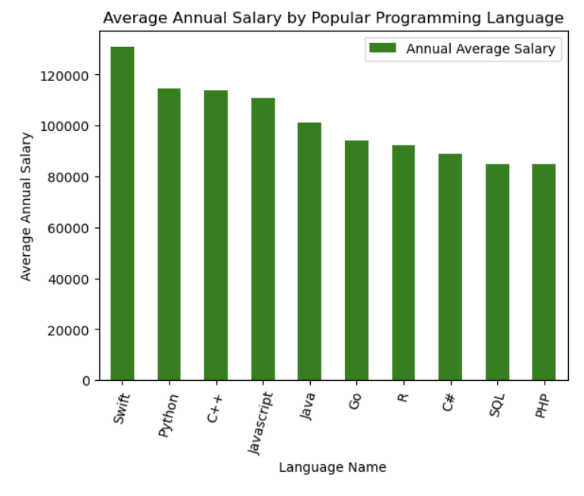
POPULAR LANGUAGES

Slide 51
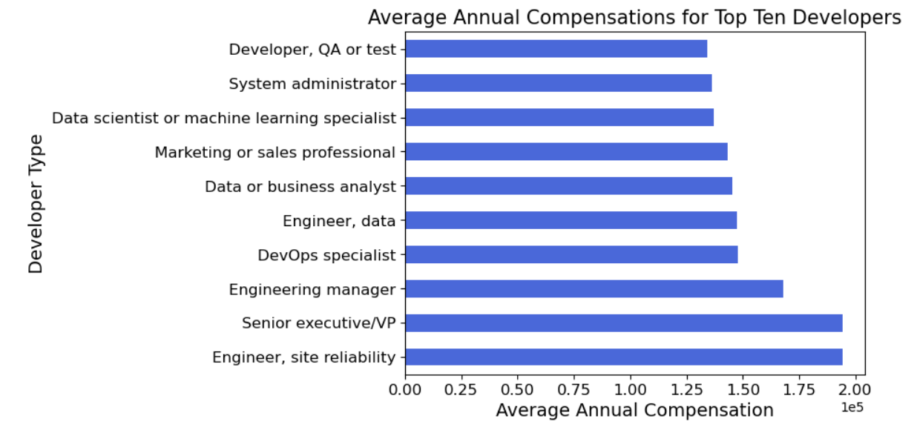
Average Annual Compensations by developer type

